Slide 1
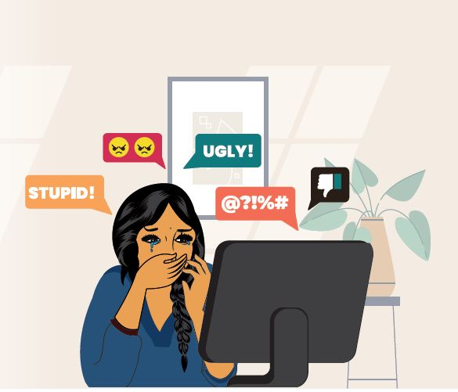
Cyberbullying Detection using Hybrid RNN and LSTM

Slide 2
Introduction
Cyberbullying is a pervasive issue in today's digital era, particularly on social media platforms. This project aims to develop a model to detect cyberbullying based on comments extracted[Web Scraping] from social media platforms such as YouTube and Reddit.
To accomplish this, text cleaning methods will be applied to remove noise from the data, including special characters, emojis, and URLs, followed by tokenization to break down the comments into analyzable components.
The processed dataset will then be used to train a machine learning model, experimenting with algorithms like Logistic Regression, Support Vector Machines (SVM), and Decision Trees and neural networks to identify the most effective approach for detecting offensive and harmful content accurately.

Slide 3
Data Labeling
Manual Labeling
After cleaning the data, we manually labelled the comments as 'cyberbullying' or 'non-cyberbullying'. This labeling process was crucial in providing labeled training data for the machine learning model.
In labeling,
1 for Cyberbullying
0 for Non Cyberbullying
Initially, comments scraped from a single platform resulted in a biased dataset that didn’t fully represent the diversity of online interactions. To create a more balanced and unbiased dataset, we included comments from both YouTube and Reddit, ensuring the model captures a broader range of language patterns and behaviors.
Automatic labeling
To automate labeling, we used the "unitary/toxic-bert" model to classify comments as "cyberbullying" or "non-cyberbullying" based on toxicity scores. Comments with scores above a set threshold are labeled as "cyberbullying”.
Modules Used - AutoTokenizer, AutoModelForSequenceClassification , torch

Slide 4
Data Collection and Data Preprocessing
We collected data by web scraping comments from YouTube and Reddit. We used the YouTube Data API to extract comments and PRAW libraries for scraping Reddit. The collected data was stored as CSV files for further processing.
After collecting the data, we performed several text cleaning operations to remove unwanted characters, URLs, emojis, and punctuation. We also removed extra whitespaces to prepare the text for further analysis.
Module Used - Regular Expression (import re)
Tokenization is the process of splitting text into smaller units, like words or phrases, to make it analyzable for machine learning models. It helps convert raw text into structured data that models can interpret effectively.
Modules Used - Natural Language Toolkit (Nltk) , tokenize , stopwords
Removing stopwords involves eliminating common words like "and," "the," and "is" that don't add significant meaning to text analysis. This process helps improve model efficiency by focusing on more relevant words in the data.

Slide 5
Phase 1: Web Scraping & Data Preprocessing
Retrieved data using the YouTube Data API v3 to gather video comments.
Processed and cleaned the data by removing unwanted elements, normalizing text, and breaking down sentences into tokens.
Performed initial data analysis to understand the comment patterns and potential challenges.
Phase 2: Data Splitting & Model Training
Classified the data into two groups: Cyberbullying and Non-Cyberbullying.
Used several classifiers, including Logistic Regression, SVM, and Random Forest, to train the model and assess performance.
Tuned hyperparameters to optimize each model's accuracy and efficiency.
Phase 3: Model Training using Neural Network
Trained the LSTM and RNN models on the updated dataset to improve the accuracy of cyberbullying detection.
Incorporated additional data to refine the model's ability to classify comments effectively.
Evaluated model performance and accuracy to assess detection improvements.
Phase 4: GUI Development with Flask & Gradio
Built a user interface with Flask for interaction and model evaluation.
Integrated the trained model within the web interface and performed tests with new data.
Added functionalities for real-time feedback and error handling to improve user experience.

Slide 6
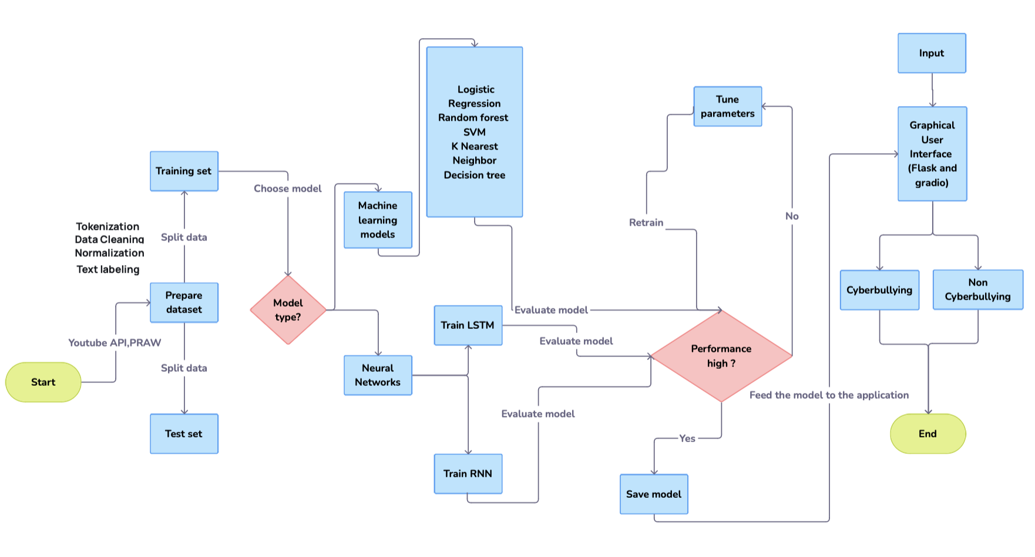
Workflow of the process

Slide 7
Model Training
Feature Extraction and Model Selection
The preprocessed text data was converted into numerical format using TF-IDF Vectorization. Multiple models, including Logistic Regression, Random Forest, and LSTM, were trained to identify the most effective approach.
Evaluation and Integration
The best-performing model, LSTM, was selected based on metrics like accuracy and F1-score. It was then integrated into the system to provide real-time, personalized career recommendations.
Modules Used for Model Training
Scikit-learn: For traditional machine learning models like Logistic Regression and Random Forest, and evaluation metrics.
TensorFlow/Keras: For building and training deep learning models such as LSTM.
Pandas: For data manipulation and preparation.
NumPy: For numerical computations and matrix operations.
Matplotlib/Seaborn: For visualizing model performance metrics.

Slide 8
Advanced models using RNN-LSTM
RNN is a type of neural network designed to process sequential data, such as time series, text, or audio.
LSTM is a special type of RNN designed to overcome the limitations of standard RNNs.
WHY RNN-LSTM
They are excellent at analyzing and predicting patterns in data.
LSTM is particularly effective in text-based tasks, as it can capture the context and relationships between words over long sentences.
LSTM captures subtle details in comments or messages by analyzing context, tone, and word sequence, thereby enhancing detection accuracy,

Slide 9
Statistical Analysis of Model training data
Model | Test Size (20%) | Test Size (25%) | Test Size (30%)
Logistic Regression | 78.17 | 78.16 | 78.05
Random Forest Classifier | 76.21 | 75.70 | 75.58
Support Vector Machine(SVM) | 78.68 | 78.61 | 78.57
Decision Tree Classifier | 74.88 | 75.33 | 74.45
K-Nearest Neighbours (K-NN) | 65.29 | 59.11 | 64.74
Long Short-Term Memory(LSTM) | 81.56 | 79.84 | 78.81
Recurrent Neural Network(RNN) | 68.57 | 73.59 | 73.42
Label | Data_Count | Percentage
Non cyberbullying | 9095 | 54.71%
Cyberbullying | 7530 | 45.29%

Slide 10
Advantages of different models
Logistic Regression is simple, efficient, and suitable for real-time applications, especially with large features.
Random Forest classifier offers high accuracy, is robust against overfitting, and handles noisy or missing data effectively.
Support Vector Machine (SVM) excels in high-dimensional data, is robust to overfitting, and flexible for both linear and non-linear classification.
K-Nearest Neighbors (KNN) is easy to implement, intuitive, and adaptable for varied datasets without a training phase.
Decision Tree classifier is highly interpretable, captures non-linear relationships, and efficiently handles both numerical and categorical data.
Long Short-Term Memory (LSTM): Excels in processing and predicting sequential data, retaining long-term dependencies, and addressing the vanishing gradient problem effectively
Recurrent Neural Network (RNN): Suitable for sequential and time-series data, capturing temporal patterns efficiently, and is adaptable for tasks like text, audio, and video analysis.

Slide 11
Software tools Used
Google Colab - provide an online, cloud-based platform for writing and executing the code
TensorFlow/Keras - For building deep learning models
scikit-learn - For data preprocessing and model evaluation
pandas - For data manipulation
Flask - For deploying the trained model
Gradio- For designing the system
matplotlib & seaborn - For data visualization and model evaluation
Git LFS - For managing large files like the trained model
VERSIONS:
Python == 3.12.3
Flask == 3.1.0
Tensorflow == 2.18.0
Keras == 3.7.0
Scikit-learn == 1.5.2
Pandas == 2.2.3
Gradio == 5.6.0

Slide 12
GUI development with flask & gradio
Flask for Backend: Use Flask to handle user requests, manage routes, and integrate with the trained model for predictions and evaluations.
Gradio for Interface Prototyping: Incorporate Gradio for rapid prototyping of the model’s UI, enabling real-time testing of predictions with minimal effort.
Seamless Model Integration: Both Flask and Gradio can easily integrate the trained machine learning model for smooth interaction and testing.

Slide 13
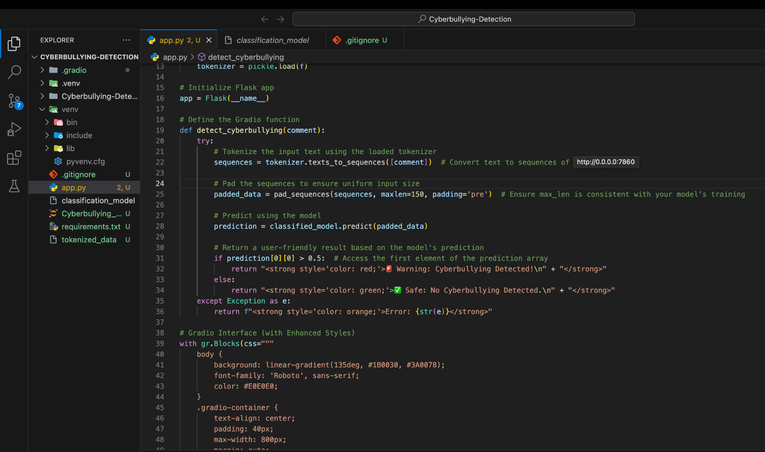
Working of the frontend

Slide 14
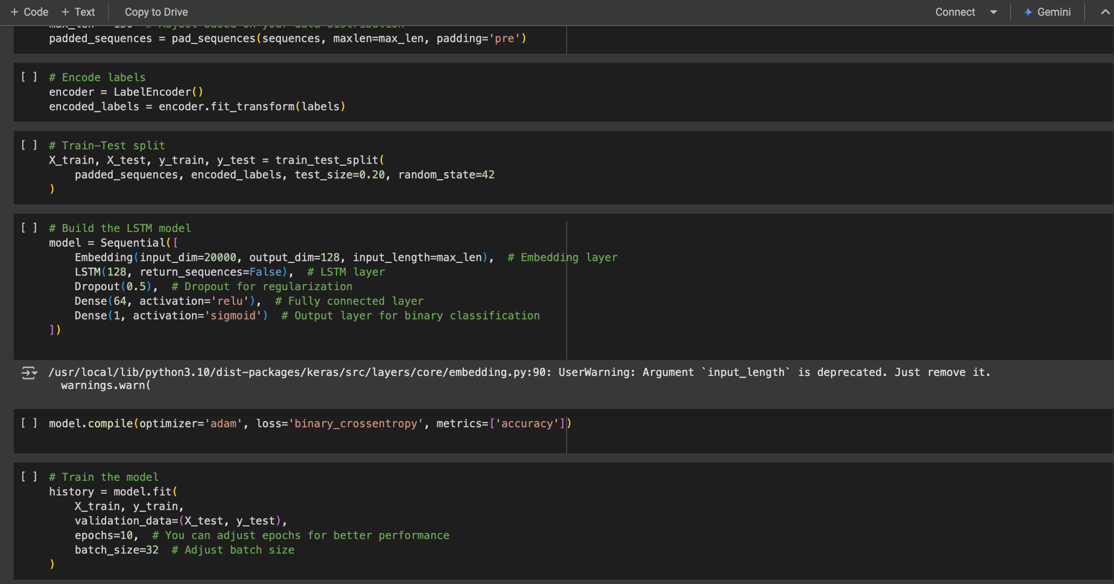
Working of the backend

Slide 15
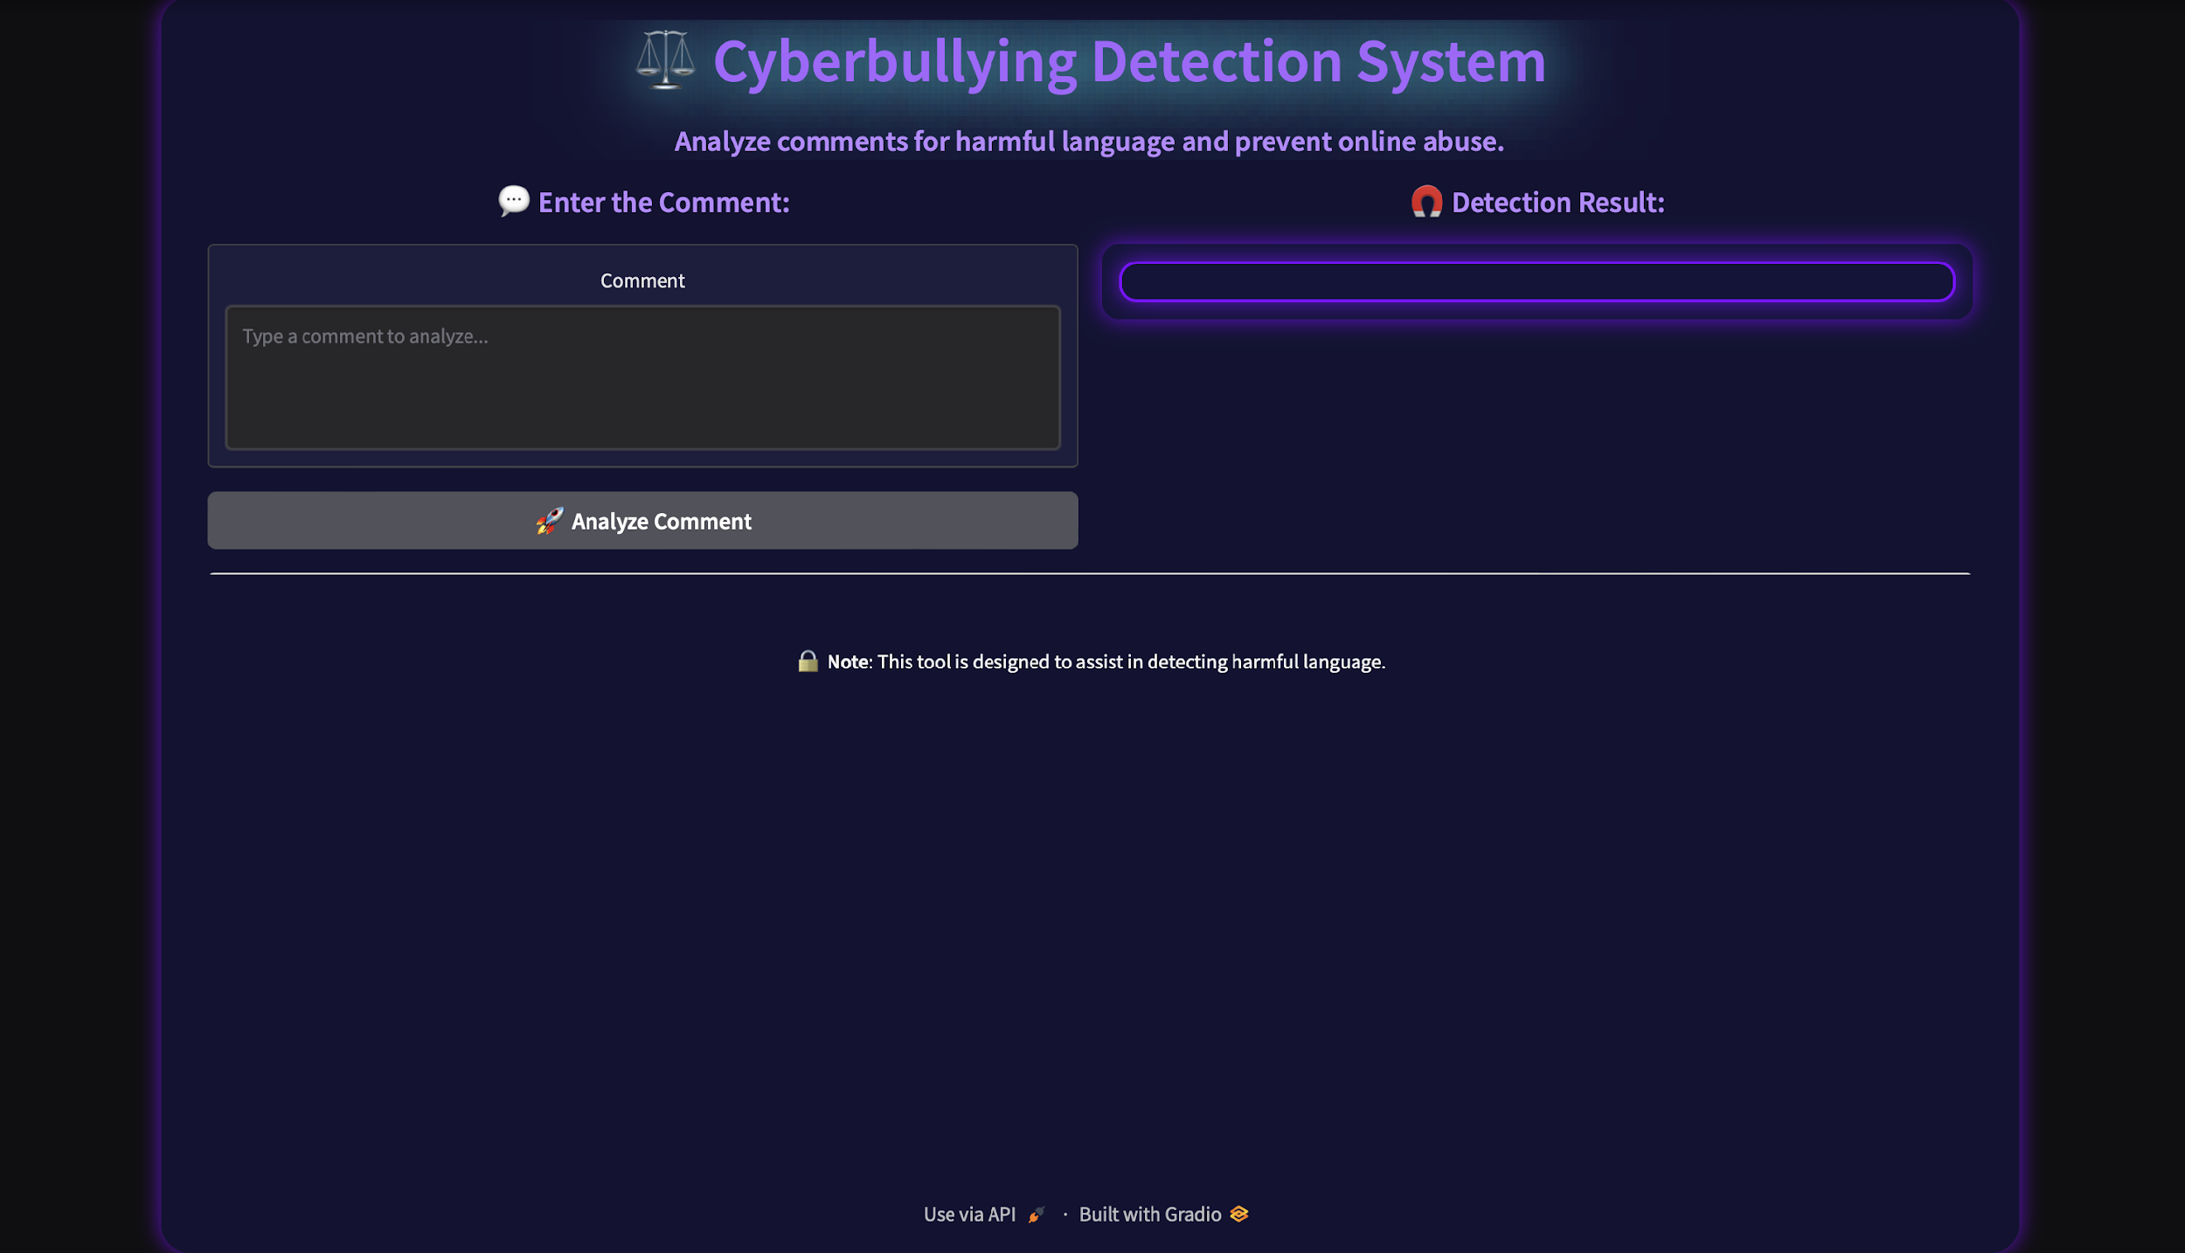
Final User Interface

Slide 16
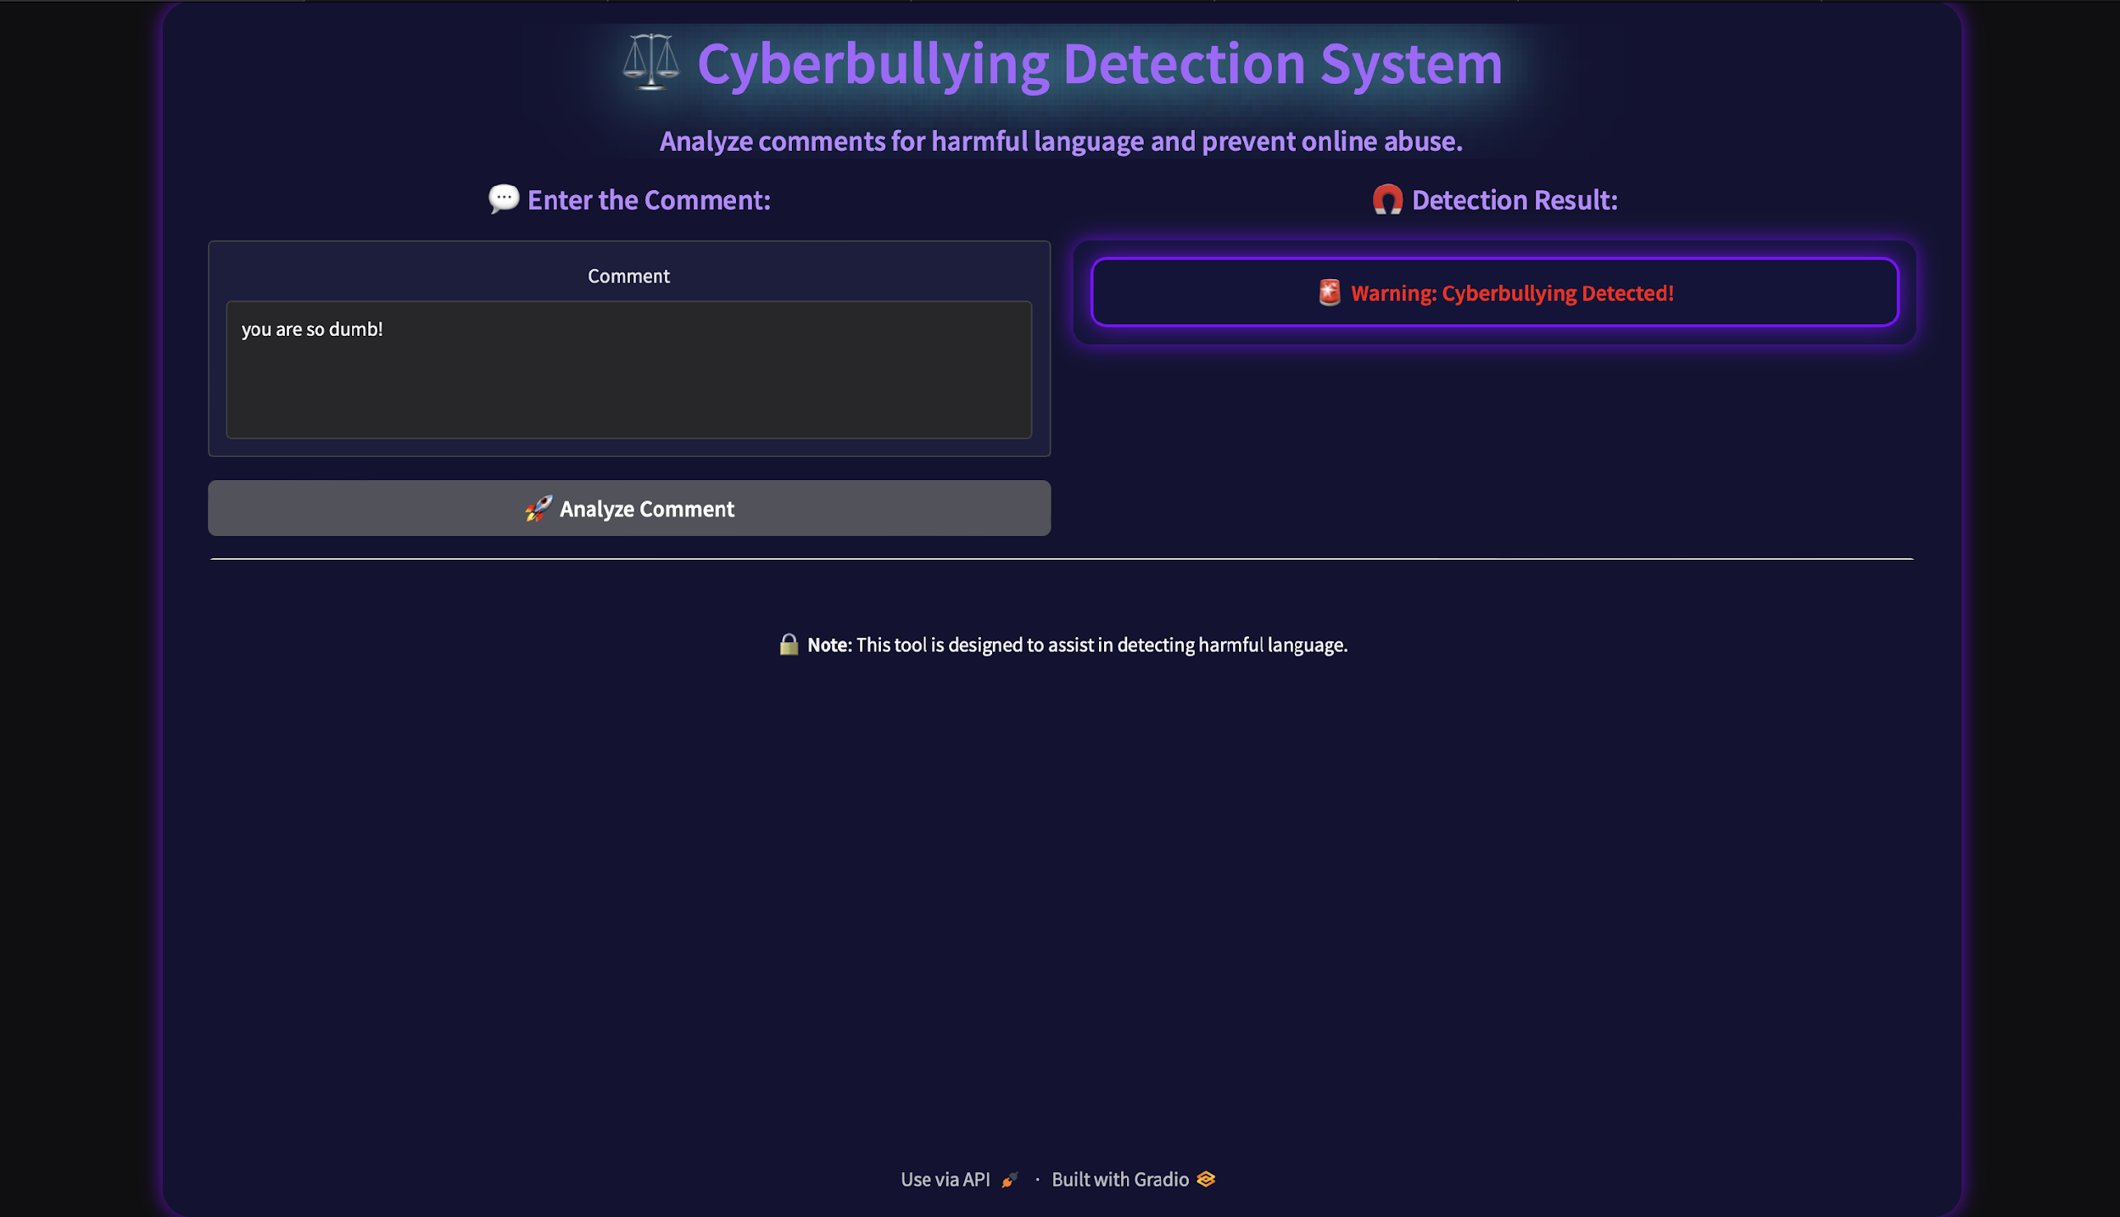
Cyberbullying detected

Slide 17
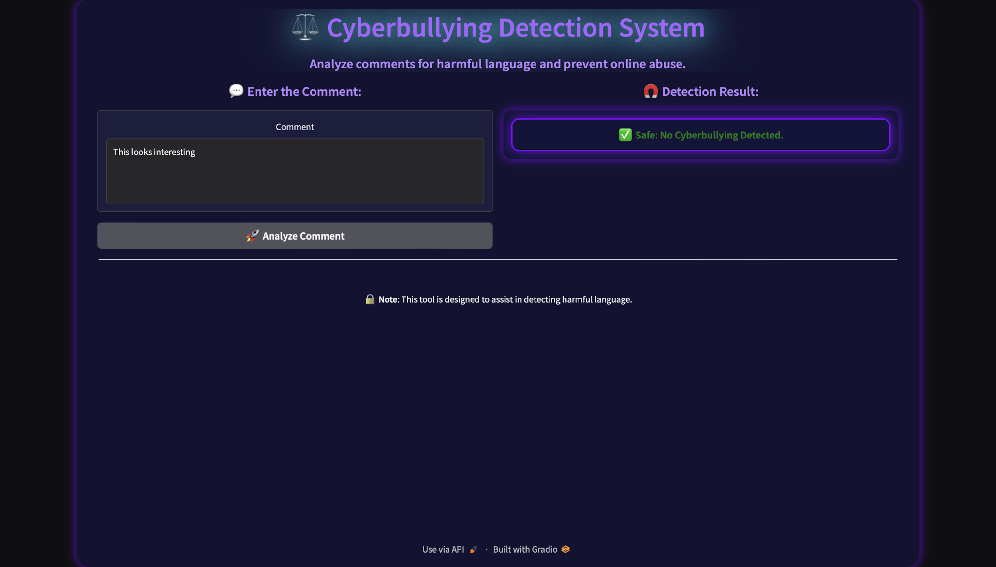
No Cyberbullying detected

Slide 18
Conclusion
Web Scraping: Data was collected from online platforms like YouTube and Reddit to gather real-world comments for analysis.
Labeling and Tokenization: Comments were labeled as cyberbullying or non-cyberbullying, followed by text preprocessing, including tokenization and stopword removal.
Model Training: Various machine learning models, including Logistic Regression, Random Forest, KNN, and SVM, were trained and evaluated for accurate cyberbullying detection.
GUI: A user interface was built using Flask to facilitate interaction and model evaluation. The trained model was integrated within the web interface, enabling tests with new data. Additional functionalities, such as real-time feedback and error handling, were incorporated to enhance the user experience.

Slide 19
Team Members
Sruthi Sai Prabha K S
Kanika B
Billa Nithin Reddy
Mohan Prasath R
Lakshmi Sowmya Mallela

